Slide 1
Web Application Development II
Week 2: CSS

Slide 2

Agenda
01
02
What is CSS?
Three Ways to Use CSS
Role of CSS in web development, separation of concerns
Inline, Internal style sheet, External style sheet
03
04
CSS Syntax & Selectors
The Box Model
Rules, cascading, properties & values
Content, padding, border, margin
05
06
Flexbox Layout
CSS Grid Layout
One-dimensional flexible layouts
Two-dimensional grid systems

Slide 3
What is CSS?
< >
{ }
ƒ()
HTML
CSS
JS
Content — nouns
Presentation — adjectives
Behaviour — verbs
Separates content from presentation (format & styling)
Makes all pages look similar and consistent site-wide
Enables site-wide changes via a single file edit

Slide 4
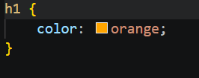

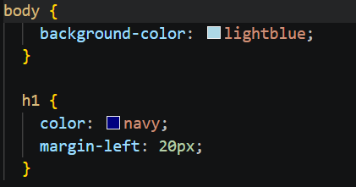
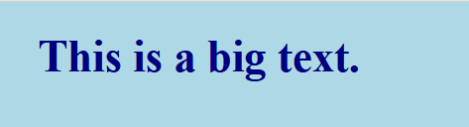
What is CSS?
wk2example1.html with wk2mystyle1.css applied
wk2mystyle1.css
● ● ● Browser Preview
wk2example1.html with wk2mystyle2.css applied
wk2mystyle2.css
● ● ● Browser Preview

Slide 5
Using CSS
Three ways
Inline style: CSS code is placed directly into an HTML element within the <body> section of a web page.
Internal style sheet: CSS code is placed into a separate, dedicated area within the <head> section of a Web page.
External style sheet: CSS code is placed into a separate file and then linked to a web page.

Slide 6
CSS: Inline Style
wk2example2.html
● ● ● Browser Preview
<body>
<h2 style="color:red;">CAUTION: Icy Road Conditions</h2>
<h2>Please Slow Down!</h2>
</body>
CAUTION: Icy Road Conditions
Please Slow Down!
CSS code is
- placed directly into an HTML element
- add the style attribute to an HTML element with the CSS declaration as the attribute value
✔ Pros
Quick for one-off overrides
No extra files needed
✗ Cons
Only affects one tag — hard to maintain
Mixes content and presentation
💡 Use sparingly — inline style overrides everything else (highest priority).

Slide 7
CSS: Internal Style Sheet
wk2example3.html
<head>
<style>
h2 { color: green; }
</style>
</head>
<body>
<h2>CAUTION: Icy Road Conditions</h2>
<h2>Please Slow Down!</h2>
</body>
● ● ● Browser Preview
CAUTION: Icy Road Conditions
Please Slow Down!
To use an internal CSS style sheet, we add a <style> section within the <head> of the page. All our CSS declarations go within this section.
✔ Pros
Good for single-page project or unique per-page styles.
💡 A <style> block inside <head> — rules apply to all matching elements on that page.

Slide 8
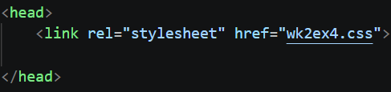
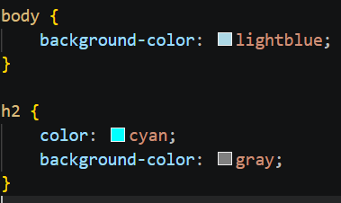
CSS: External Style Sheet
wk2ex4pg1.html
wk2ex4pg1.html
wk2ex4.css
wk2ex4pg2.html
mystyle.css
wk2ex4pg3.html
✔ Pros
Best Practice: One CSS file controls the look of your entire site.
💡 Styles declared in external style sheet will affect all matching elements on all web pages linked to that style sheet.

Slide 9
Using CSS
Method | Scope | Separates Content? | Best Used When
Inline | One tag only | ✗ No | Quick one-off fixes, use sparingly
Internal | One page | Somewhat | Single-page or small sites
External | All linked pages | ✔ Yes | Multi-page sites

Slide 10
CSS Syntax
The syntax of CSS
selector { property: value; }
A semicolon must be placed after each CSS declaration.
Omitting this semicolon is the single most common mistake made by those learning CSS.
/* Single property */
p { color: red; }
h1 { font-style: italic; }
/* Multiple properties - same selector */
p {
color: red;
font-style: italic;
text-align: center;
}
/* Group selectors */
h1, h2 { color: blue; }
💡 We can have as many properties as we want to style within a single selector.

Slide 11
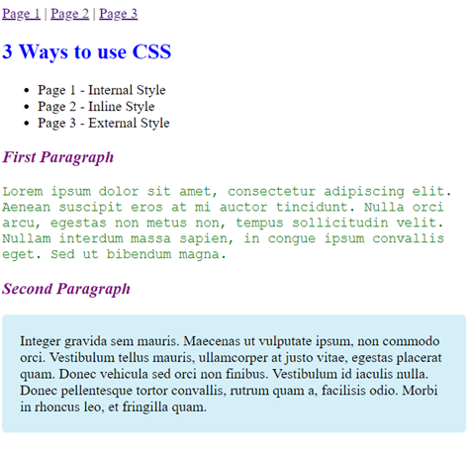
Exercise 1
Given ex1-Page1.html, build ex1-Page2.html and ex1-Page3.html such that
They have the same appearance as ex1-Page1.html.
ex1-Page2.html uses inline style sheet.
ex1-Page3.html uses external style sheet only.

Slide 12
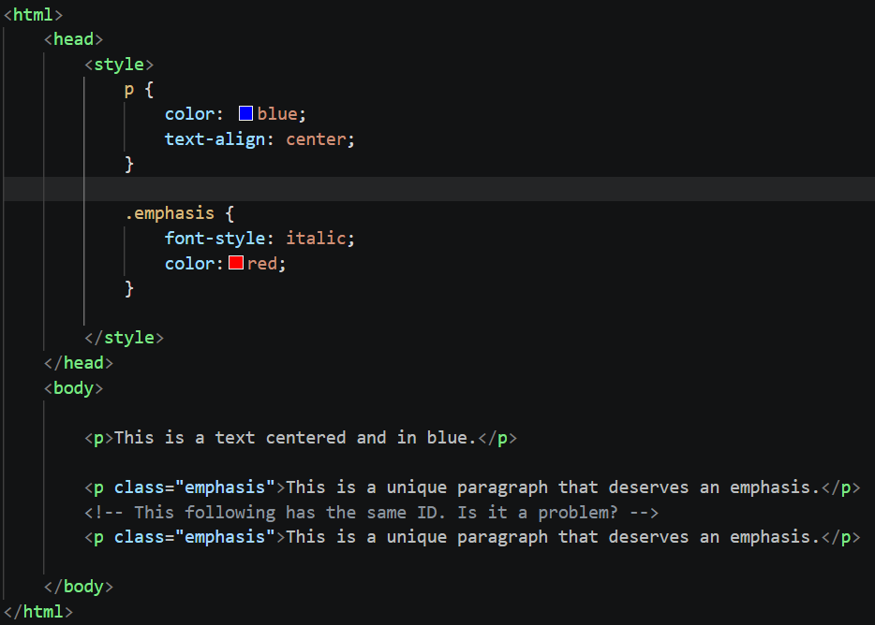
CSS Syntax: Selector types
wk2example4.html
p
#id
Element Selector
ID Selector
.cls
*
Class Selector
Universal

Slide 13
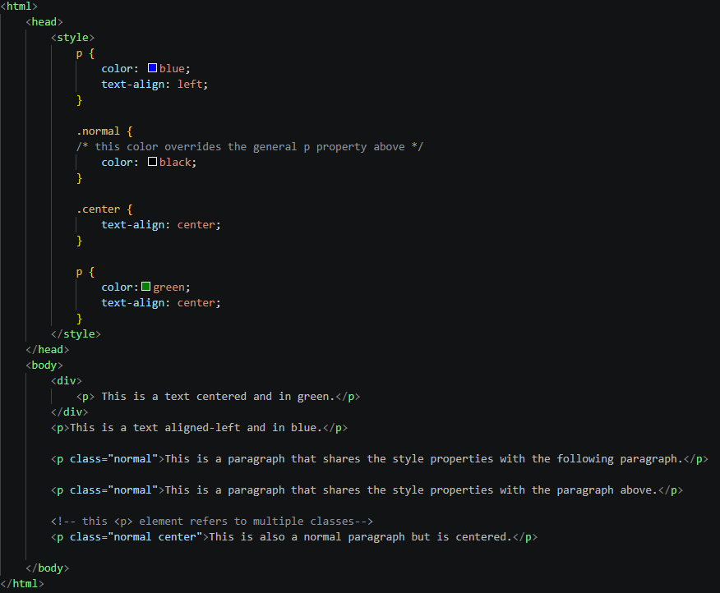
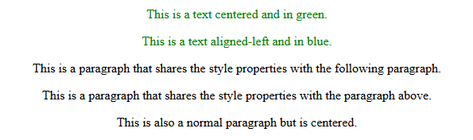
CSS Syntax: Class selector
wk2example5.html
● ● ● Browser Preview
💡 Class selectors has a higher priority(specificity) over element selectors.

Slide 14
CSS Selectors
There are many selectors in CSS.
A reference list is here:
https://www.w3schools.com/cssref/css_selectors.asp
Some Exotic Examples
* | Select all elements
input:checked | Select checked input fields and dropdown item
input:focus | Select input fields currently highlighted by the user's cursor or keyboard
:not(p) | Selects every element that is not a <p> element
... | ...

Slide 15
CSS Cascading Order
1. Inline Style
Highest priority
2. Internal / External (last defined)
Same priority — last wins
3. Browser Default
Lowest priority
wk2example6.html
<head>
<style>
h2 { color: red; } /* internal */
</style>
</head>
<body>
<h2 style="color: green;">CAUTION</h2>
</body>
/* Result: green (inline wins over internal) */
● ● ● Browser Preview
CAUTION

Slide 16
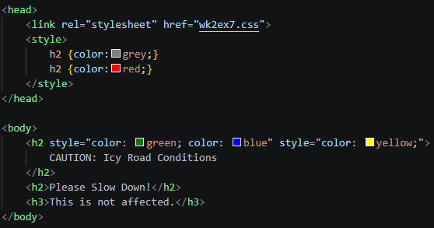
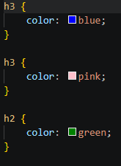
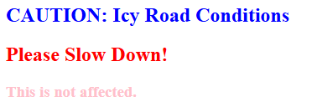
CSS Conflict Resolving
wk2example7.html
wk2ex7.css
If multiple conflicting styles are defined with the same priority, the conflict is resolved as follows (assuming a left-to-right, top-to-bottom processing order).
For inline style, the first one (style attribute) applies.
For internal or external style sheet, the last one applies.
● ● ● Browser Preview

Slide 17
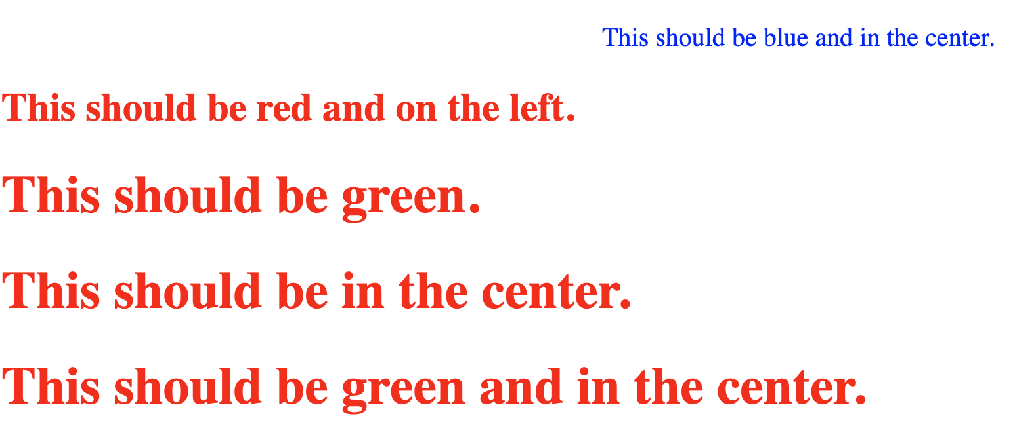
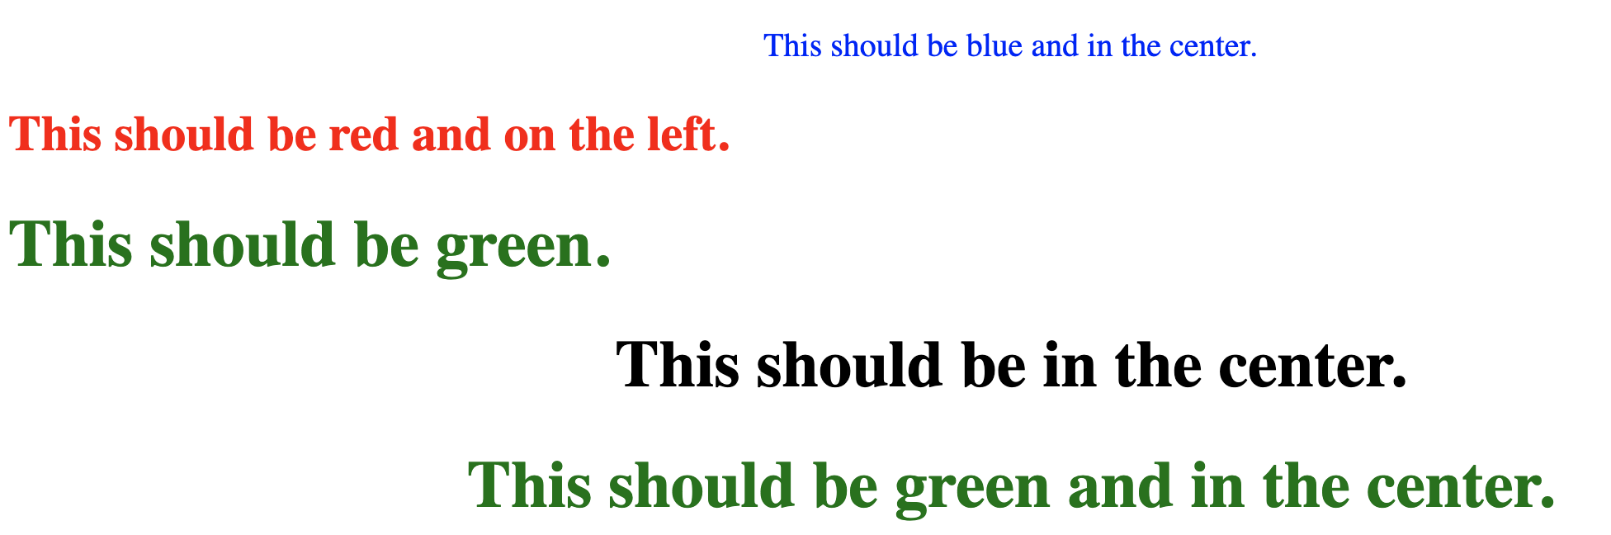
Exercise 2
CSS Debugging
Given ex2.html, read the text and identify the problems.
Fix the bugs so that the text is consistent with its style.

Slide 18
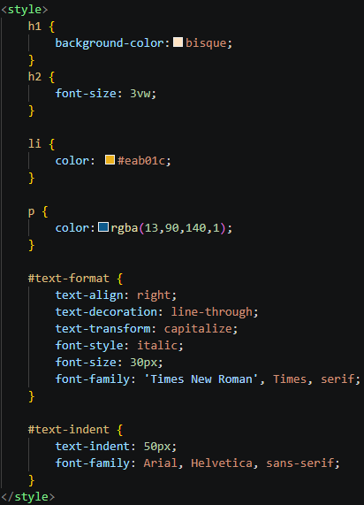
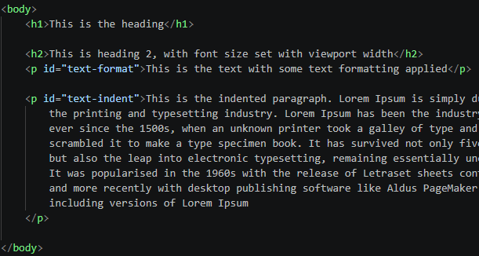
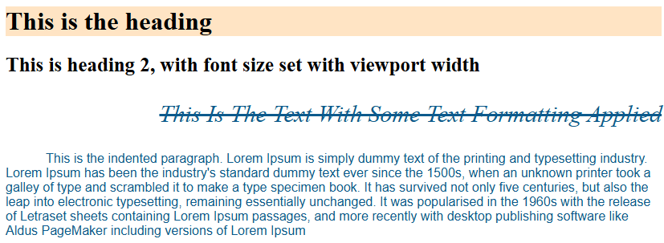
CSS: Text properties
wk2example8.html
Text display properties
Color: specify the color of the text
Text-align: specify horizontal alignment
Text-decoration: e.g., p { text-decoration: line-through; }
● ● ● Browser Preview
💡Reference list of properties: https://www.w3schools.com/cssref/

Slide 19
CSS: Display properties
Display properties
Specifies how an element is displayed with respect to other elements.
block: displayed on a new line
inline: displayed inline with the previous element, i.e., place this element next to the previous one.
none: hidden (used with JavaScript to hide/show elements depending on logic)
💡 Every HTML element has a default display value.

Slide 20
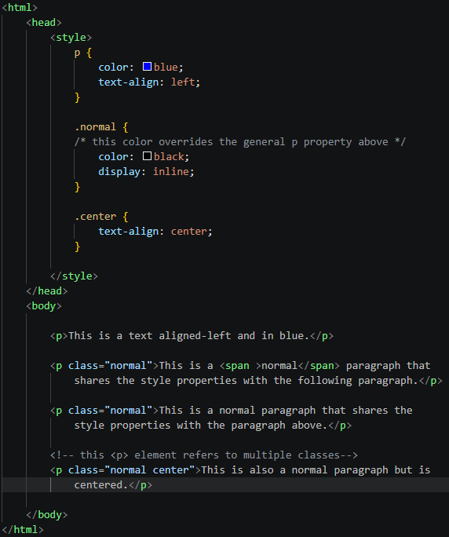
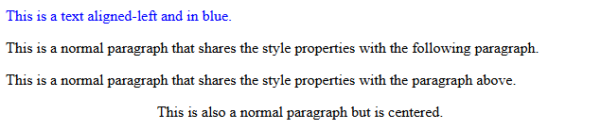
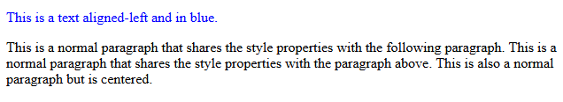
CSS: Display properties
wk2example9.html
● ● ● Browser Preview
if “display: inline” is omitted
if “display: inline” is included
● ● ● Browser Preview
💡Video to explain differences: inline, block and inline-block

Slide 21
CSS: Other properties
Category | Property | Example value
Font properties | font-family | “Times New Roman”
 | font-style | italic
 | font-size | default = 16px
Background properties Example: wk2example10.html | background-color | blue
 | background-image | url(“mysite.site/head.png”)
... | ... | ...

Slide 22
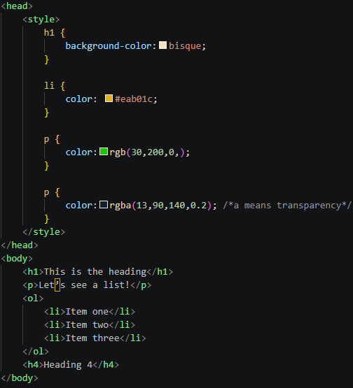
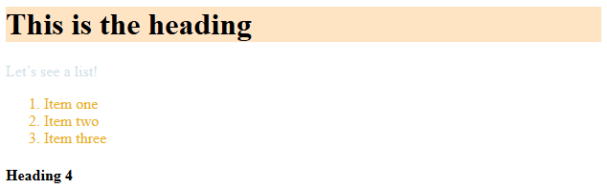
CSS: Color values
wk2example11.html
● ● ● Browser Preview
Color values
hex color value (Google): #eab01c
rgb values : (30, 200, 0)
rgba: red, green, blue, alpha (where alpha is 0 means “fully transparent” and 1 means “fully opaque”)

Slide 23
CSS: Units of Measurement
Some CSS values such as values for font-size, width, height, margin, and padding have different units of measurement.
Absolute length:
in (inches)
cm (centimeters)
px (pixels, 1px = 1/96*1inch)
Relative length:
% (percentage)
em (relative to parent element’s font-size)
vw (1vw = 1% of the width of the viewport - browser window size)

Slide 24
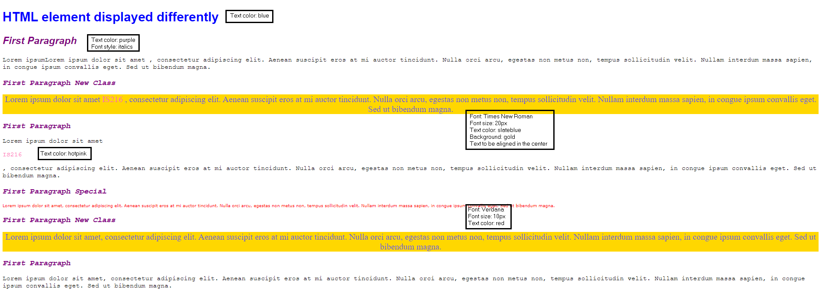
Exercise 3
Given ex3.html, create the view below using Internal Style sheets.

Slide 25
The Box Model
Margin
Margin
Border
Space outside border (transparent)
Padding
Border
Visible line around padding & content
Content
Padding
Space between border & content (transparent)
Content
Text or images
💡Every HTML element is a box comprising of margin, border, padding and content which can be decorated using CSS.

Slide 26
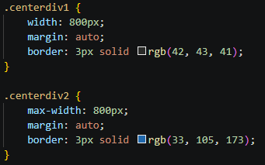
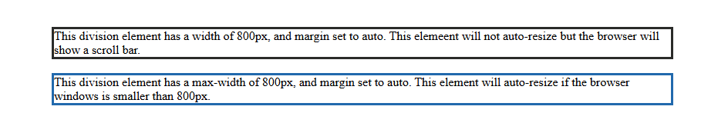
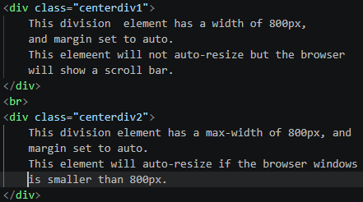
Decorating Content and Border
wk2example12.html
● ● ● Browser Preview
💡Setting “margin: auto” centres the div element horizontally.
Notes:
margin : auto -> the browser calculates the margin

Slide 27
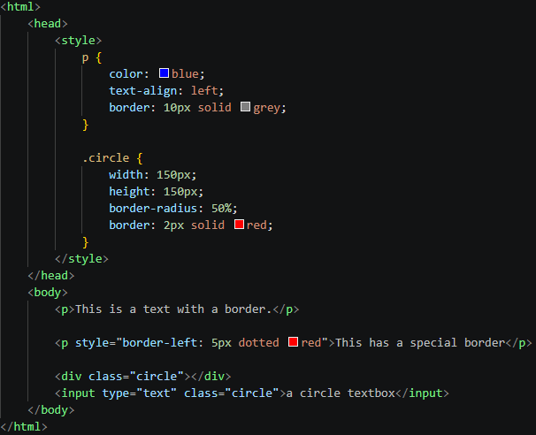
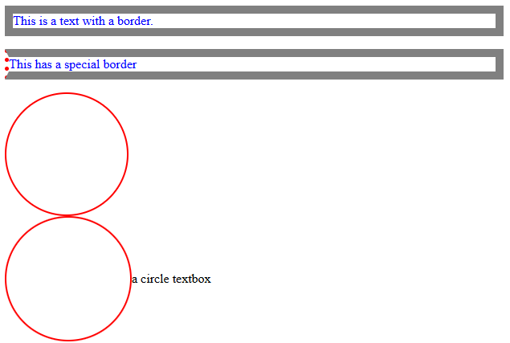
Decorating Border
wk2example13.html
● ● ● Browser Preview
Use border-left, border-right, border-top, border-bottom properties to specifically style the left, right, top, or bottom of a border separately.
Use border-radius to created rounded corners. You can specify different border radius for the 4 corners.

Slide 28
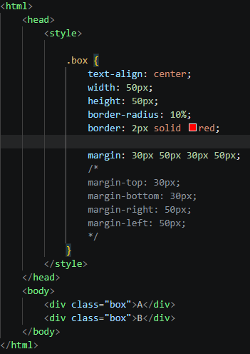
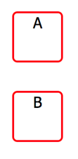
Decorating Margin
wk2example14.html
Use margin-top, margin-right, margin-bottom, margin-left properties to create space around (top, right, bottom, and left) an element’s content, outside of its border.
Additionally, property values can be specified with the following.
auto - horizontally center the element within its container
length - specifies a margin in px, pt, cm, etc.
% - specifies a margin in % of the width of the containing element
inherit - specifies that the margin should be inherited from the parent element
● ● ● Browser Preview
💡Setting “margin: 30px 50px” achieves the same effect as “margin: 30px 50px 30px 50px”.

Slide 29
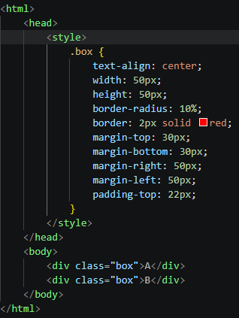
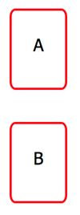
Decorating Padding
wk2example15.html
Use padding-top, padding-right, padding-bottom, padding-left properties to generate space around an element's content, inside the border.
● ● ● Browser Preview

Slide 30
Box-sizing
It controls how an element’s total size is calculated — whether padding and borders are inside or outside the width/height you set.
wk2example20.html
 | content-box (default) | border-box (recommended)
Width includes | Content only | Content + Padding + Border
Total size | width + padding + border | width (everything included)
Result | May overflow container | Stays within set size
💡Video to further explain box-sizing

Slide 31
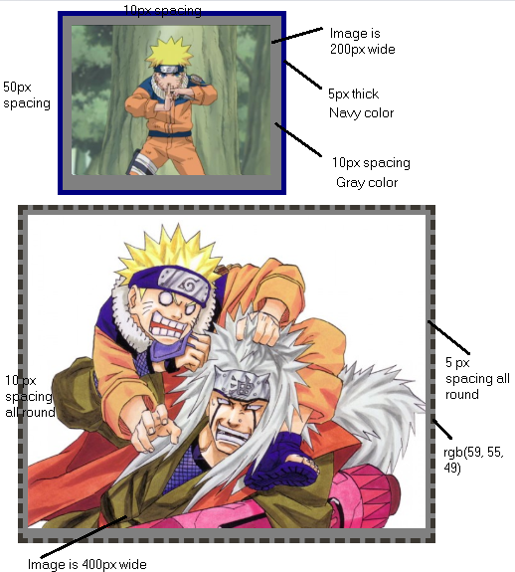
Exercise 4
Modify the internal style sheet in ex4.html to make it looks as close as possible to the ones on the right.
Images are in the “img” folder (naruto1.jpg, naruto2.jpg).
You do not have to use all the selectors if you so prefer.

Slide 32
Table Styling
Property
border: specify border size, style (solid, dashed, dotted) and color, e.g.,
table, th, td { border: 1px dashed blue; }
Property
border-bottom: horizon dividers for <th> and <td>, e.g.,
th, td { border-bottom: 1px solid black; }
Property
border-collapse: collapse into a single border, e.g.,
table { border-collapse: collapse; }
Property
tr:hover : highlight table rows on mouse over, e.g.,
tr:hover { background-color: red; }

Slide 33
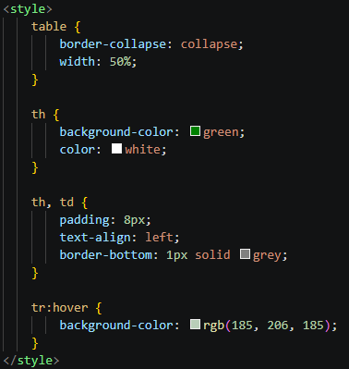
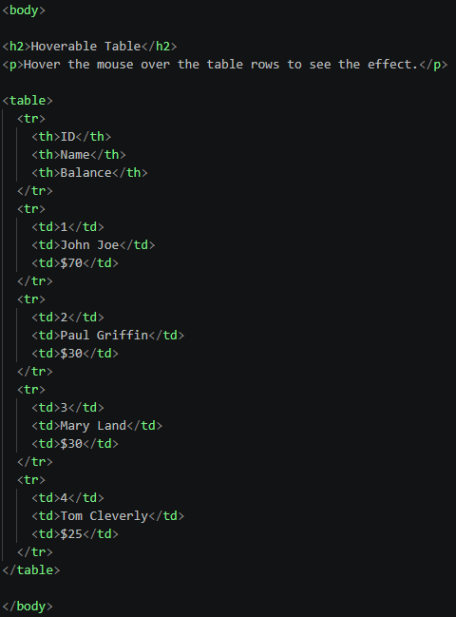
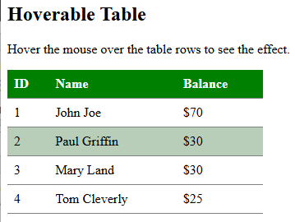
Table Styling
wk2example16.html
● ● ● Browser Preview
Mouse over effect

Slide 34
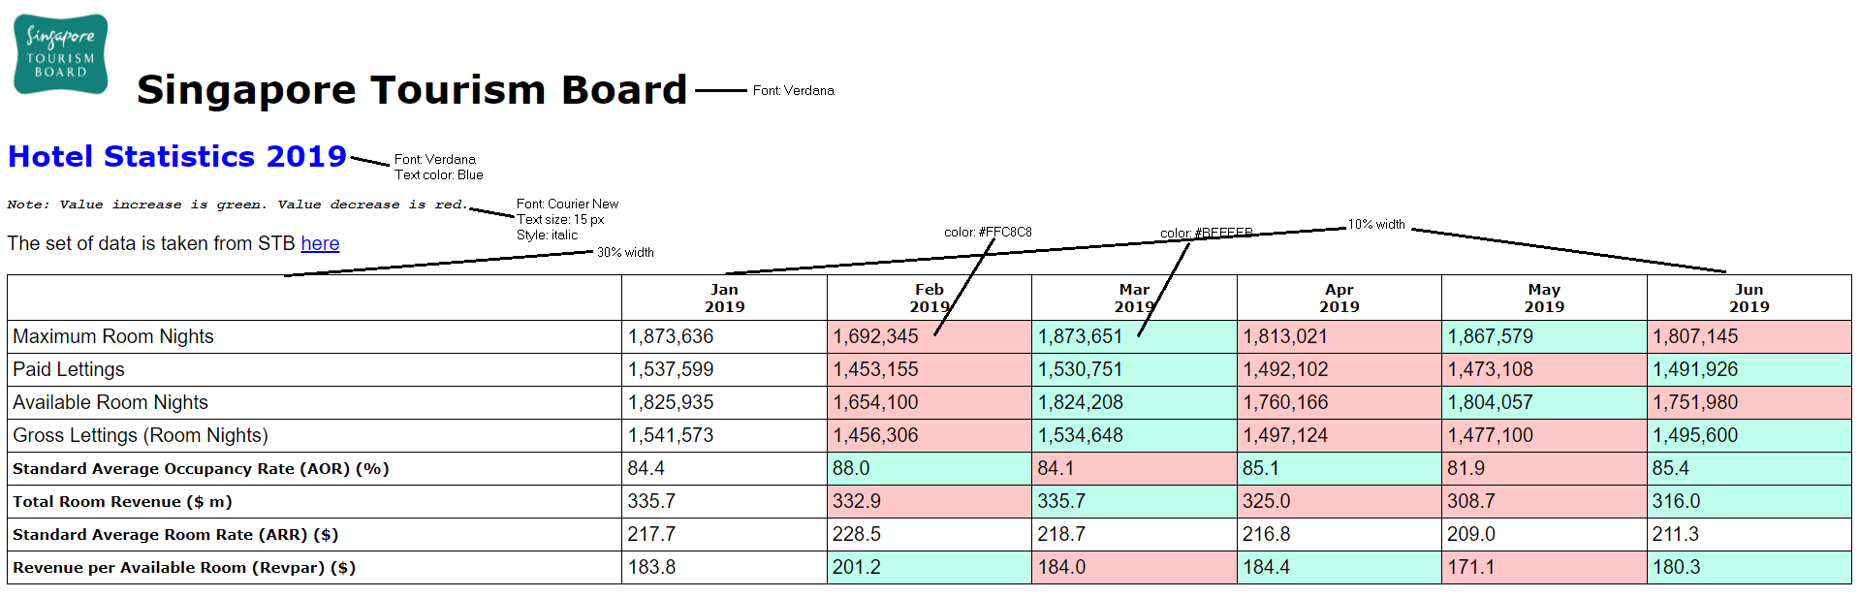
Exercise 5:
Given ex5.html, provide an external CSS style sheet named ex5.css so that the page looks like the one below. Note that the table stretches to the full width of the page. Do not worry about the exact color.
5 px spacing for all table cells
40% width

Slide 35
Link Properties
Links can be styled with any CSS property (e.g. color, font-family, background, etc.).
links can also be styled differently depending on what state they are in.
a:link - a normal, unvisited link
a:visited - a link the user has visited
a:hover - a link when the user mouses over it
a:active - a link at the moment it is clicked
Example: wk2example18.html
/* unvisited link */
a:link { color: red; }
/* visited link */
a:visited { color: green; }
/* mouse over link */
a:hover { color: hotpink; }
/* selected link */
a:active { color: blue; }

Slide 36
List Properties
List style properties can be used to style ordered lists (<ul>) and unordered lists (<ol>):
Set different markers
Set an image as marker
Add background colors
Example: wk2example19.html
<ul class="a">
<li>Coffee</li> <li>Tea</li>
</ul>
<ol class="c">
<li>Coffee</li> <li>Tea</li>
</ol>
ul.a { list-style-image: url(`img.png`); }
See: Example
ol.c { list-style-type: upper-roman; }

Slide 37
Position Properties
Value | Remark
static | Default value. Elements render in order, as they appear in the document flow
absolute | The element is positioned relative to its first positioned (not static) ancestor element
fixed | The element is positioned relative to the browser window
relative | The element is positioned relative to its normal position, so "left:20px" adds 20 pixels to the element's LEFT position
sticky | The element is positioned based on the user's scroll position. A sticky element toggles between relative and fixed, depending on the scroll position. It is positioned relative until a given offset position is met in the viewport - then it "sticks" in place (like position:fixed).
Example:
wk2example17.html

Slide 38
Relative vs Absolute
A relative positioned element can be moved to any direction by using the properties(offset properties) such as left, right, top and bottom. And the values provided in those properties is calculated based on the position where the element sits. And the surrounding elements of a relative positioned element is aware of its existence in the document flow. So, they don’t consume the space of the relative positioned element after it has been moved to a different position on the page.
In absolute positioned element, the surrounding elements consume the space of the absolute positioned element. An absolute positioned element can be moved using properties (offset properties) such as left, right, top and bottom, but the values provided in those properties are calculated based upon its closest ancestor’s container that has a relative position.
💡Video to further explain Relative vs Absolute

Slide 39
Overlapping Elements
When elements are positioned, they can overlap other elements.
The z-index property specifies the stack order of an element (which element should be placed in front of, or behind, the others).
An element can have a positive or negative stack order
Example
img {
position: absolute;
left: 0px;
top: 0px;
z-index: -1;
}
https://www.w3schools.com/cssref/tryit.asp?filename=trycss_anim_z-index

Slide 40
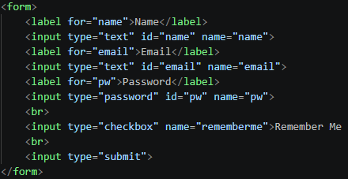
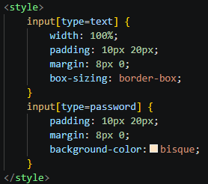
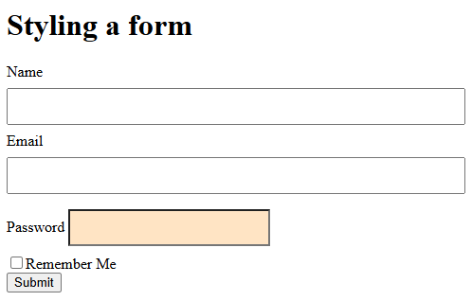
Styling Forms
wk2example20.html
● ● ● Browser Preview
We can use various CSS properties we have learnt to improve the look of HTML forms. For styling of buttons and select menu, refer to wk2example21.html

Slide 41
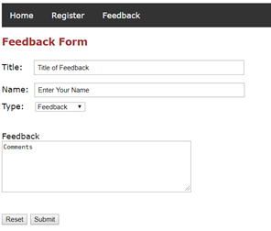
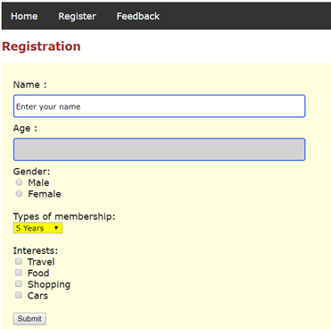
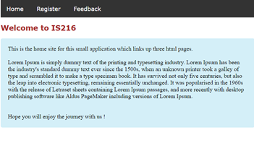
Exercise 6
The Ex6 folder contains three webpages:
Home – mainly text based
Register – a registration form for a user
Feedback – a form which allows a user to submit feedback
Beautify these pages (the best you can) with the help of internal/external style sheets. You are free to add in pictures too.
Your pages do not have to look like the ones on the right.

Slide 42
Flexbox – Core concept
.container {
display: flex; /* Enable Flexbox */
flex-direction: row; /* row | column | row-reverse | column-reverse */
justify-content: center; /* align along main axis */
align-items: center; /* align along cross axis */
gap: 16px; /* space between children */
flex-wrap: wrap; /* allow wrapping */
}
.container { display: flex; }
A
B
C
D
↑ Items flow in a row (flex-direction: row)
justify-content
flex-start | center | flex-end | space-between | space-around
align-items
flex-start | center | flex-end | stretch | baseline
flex-direction
row | column | row-reverse | column-reverse
flex-wrap
nowrap | wrap | wrap-reverse
flex (on child)
flex: 1 → takes equal share of remaining space

Slide 43
Flexbox
justify-content (Main Axis):
A
B
C
A
B
C
A
B
C
flex-start
center
flex-end
A
B
C
A
B
C
space-between
space-around
align-items (Cross Axis):
flex-start
center
flex-end
stretch

Slide 44
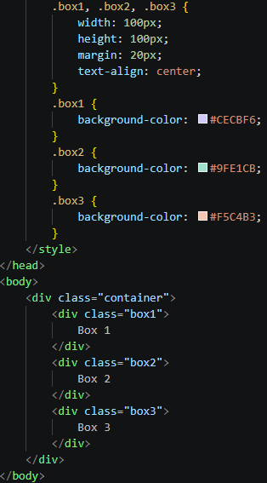
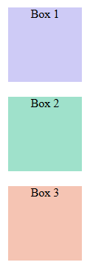
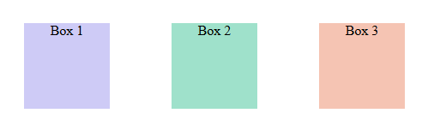

Flexbox
wk2example22.html
● ● ● Browser Preview
● ● ● Browser Preview
After adding this:

Slide 45
Grid – Core concept
Example:
wk2example23.html
Grid = explicit rows + columns. Items placed in cells or spanning across them.
.grid-container {
display: grid;
/* 3 columns: first fixed, middle flexible, last fixed */
grid-template-columns: 200px 1fr 200px;
/* 3 rows with explicit heights */
grid-template-rows: 60px 1fr 40px;
/* Gap between cells */
gap: 12px;
}
/* Child spanning multiple columns */
header, footer {
grid-column: 1 / 4; /* span all 3 columns */
}
header (grid-column: 1/4)
sidebar
main
(1fr)
aside
footer (grid-column: 1/4)

Slide 46
Grid: Template areas
Example:
wk2example24.html
.page {
display: grid;
grid-template-columns: 1fr 3fr;
grid-template-rows: auto 1fr auto;
grid-template-areas:
"header header"
“sidebar main"
"footer footer";
gap: 10px;
min-height: 90vh;
}
header { grid-area: header; }
aside { grid-area: sidebar; }
main { grid-area: main; }
footer { grid-area: footer; }
header
sidebar
(1fr)
main
(3fr)
footer
fr = fractional unit — 1fr 3fr means sidebar gets ¼ of width, main gets ¾.
grid-template-areas uses named regions — readable and easy to reorganize.

Slide 47
Flexbox vs Grid
 | Flexbox | CSS Grid
Dimensions | One-dimensional (row OR column) | Two-dimensional (rows AND columns)
Best For | Navigation bars, toolbars, button groups, centering items | Page layouts, dashboards, image galleries, complex arrangements
Content vs Layout | Content-driven (items determine size) | Layout-driven (grid defines structure)
💡 Use Grid for the page skeleton, Flexbox for components inside.

Slide 48
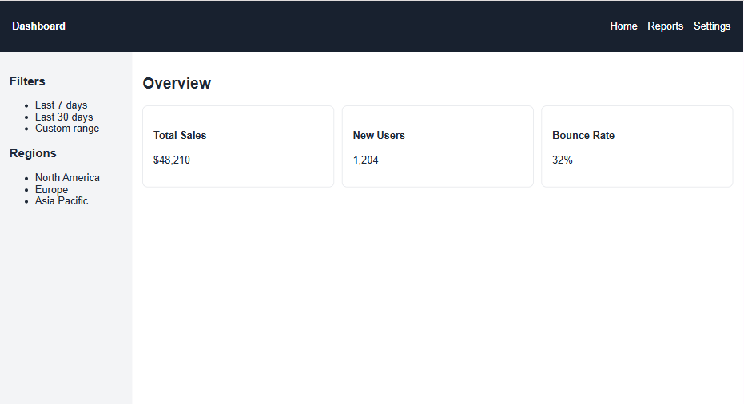
Exercise 7 – Flex and Grid Box
Use Flex box and Grid box to style ex7.html such that it looks like the screenshot on the right.
The nav bar items to be aligned in 1 line with “Dashboard” on the left and the nav items on the right.
A sidebar containing “Filters” and “Regions” with a width of 1/3 page width.
The 3 cards to be arranged in 1 line.
Detailed instructions are given in the CSS file.

Slide 49
Take Away Message
1
External > Internal > Inline
2
selector { property: value; }
Use external stylesheets for all multi-page sites.
Don't forget the semicolon! It's the most common CSS mistake.
3
The Box Model
4
Flexbox
Every element = content + padding + border + margin. Use box-sizing: border-box.
One dimension (row or column). Perfect for navbars, card rows, centering.
5
CSS Grid
6
Use both together!
Two dimensions simultaneously. Use for page-level layouts and complex grids.
Grid for the page skeleton, Flexbox for components inside. They complement each other.

